Slide 1
Introduction to Machine Learning
Business Objectives, Requirements and Development Process
Student: Paulo Eduardo da silva junior

Slide 2
Summary
Business Objectives and Machine Learning.
Requirements for Machine Learning Systems.
Iterative Development Process.
Defining Machine Learning Problems.
Objective Functions.
Mind vs. Data in Machine Learning.
Conclusion.

Slide 3
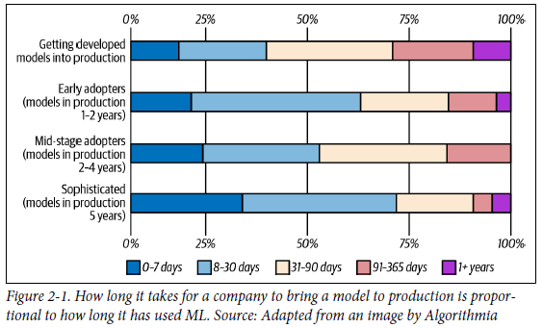
Business Objectives and Machine Learning
Impact on business metrics such as revenue and customer retention.
Focus on business metrics beyond model accuracy.
Validation through A/B testing and impact on key indicators.

Slide 4
Requirements for Machine Learning Systems
Requirements:
Reliability
Scalability
Maintainability
Adaptability

Slide 5
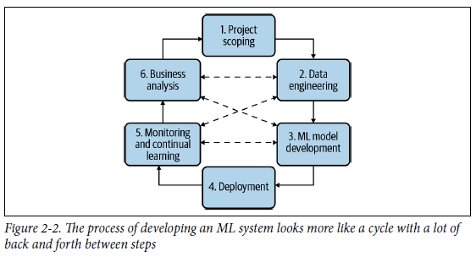
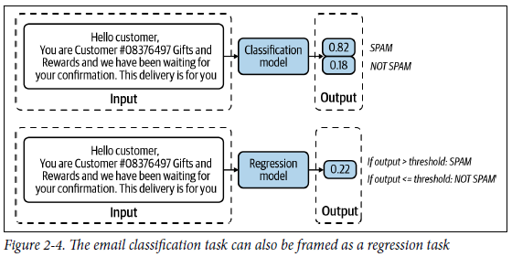
Iterative Development Process
Project definition, data engineering, model development.
Implementation, ongoing monitoring and adjustments.
Coordination and alignment with business objectives.

Slide 6
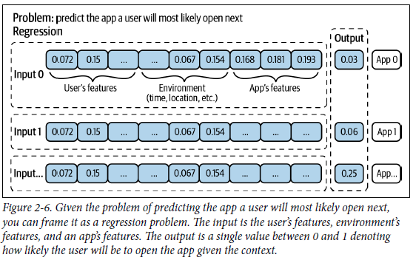
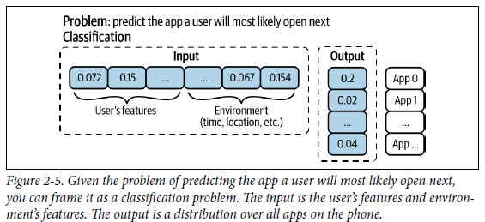
Defining Machine Learning Problems
Specifying inputs, outputs, and objective function.
Difference between classification and regression.
Simplifying problems and choosing approaches.

Slide 7
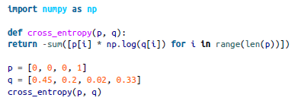
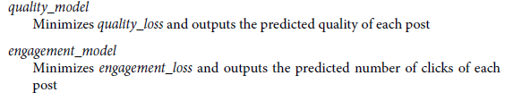
Objective Functions
Guide learning and minimize errors.
Separate multiple objectives into distinct models.
Flexibility for specific adjustments.
You want to achieve this goal through the following three objectives:
Filter out spam;
Filter out NSFW content;
Filter out misinformation;
Rank posts by quality;
Rank posts by engagement: how likely users will click on it;

Slide 8
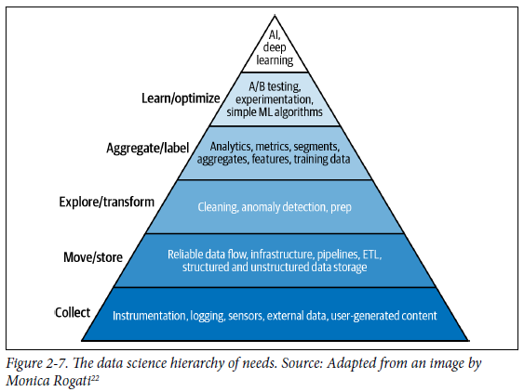
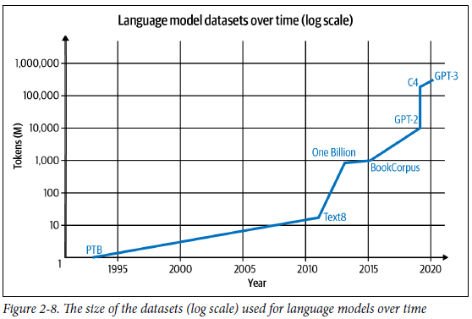
Mind vs. Data in Machine Learning
Balancing sophisticated algorithms with data volume.
Data as a driver of recent advances.
Larger models and more data = greater effectiveness.

Slide 9
Conclusion
Importance of clear business objectives.
Essential requirements: reliability, scalability, maintainability, adaptability.
Iterative process, adjusting to changes.
Next step: data engineering.

